Slide 1
Implementation of iNTELlIGENT WATER DROP Algorithm
By,
Team ISI
Iqra Siddiqui and Sara Intikhab

Slide 2
RECAP
Introduction of iwd algorithm
Implementation of iwd algorithm
Unweighted graph
Weighted graph
Performance evaluation (unweighted graph)
progress

Slide 3
Objectives of this demo
Validation of output
Performance evaluation of Algorithm (with weighted graph)
Space Complexity
Run-Time complexity
Experimental Analysis (weighted \ Unweighted)
Further room for optimization

Slide 4
VALIDATION OF OUTPUT

Slide 5
PERFORMANCE EVALUATION

Slide 6
Step No. | Run Time Complexity | Space Complexity (words)
1 | O (V^2*E) | 19
2 | O(itermax)*O(initializeIWD()) = O(itermax)*O(Niwd) | 3
3 | O(Niwd)
4 | O(Niwd)
5 | O(V)*O(E)*O(Niwd)*O(itermax) | 10
6 | O(len(quality))*O(itermax) | 2
7 | O(len(visit))*O(itermax) | 2
8 | O(1) *O(itermax)
9 | O(1) *O(itermax) | 1
10 | O(1) | 1
Assuming V<E and V=Niwd
Total Complexity = O (V)*O(E)*O(Niwd)*O(itermax)
= O(V²E* itermax)
For further details, see the File “Complexity Analysis Weighted Graph.py” on Git -> Code.
In evaluating the space complexity, we will just consider the data space.
Total Space Complexity = 18 + 3 + 10+ 2+ 2 +1 +1 = 38 Words

Slide 7
EXPERIMENTAL ANALYSIS
Things to note:
iTermax is kept constant
Input Size -> number of nodes in graph -> V
Edges -> V * (V-1)
To study relation between input size and the runtime

Slide 8
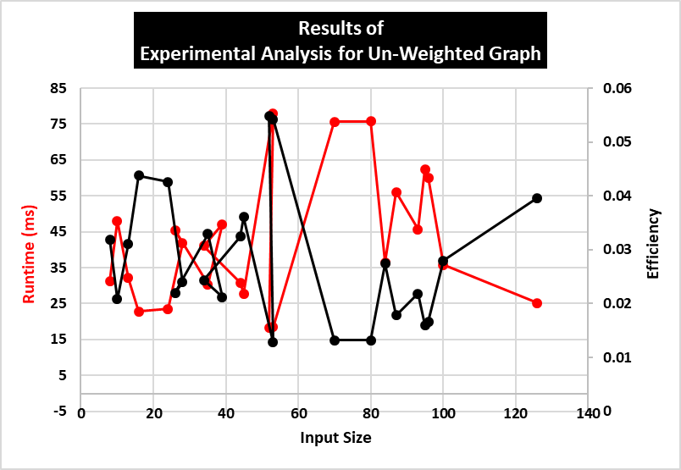

S # | Input Size |  | Time
 |  |  | secs | millisecs
1 | 8 |  | 0.031341 | 31.3409
2 | 10 |  | 0.048045 | 48.0448
3 | 13 |  | 0.032159 | 32.1594
4 | 16 |  | 0.022832 | 22.8322
5 | 24 |  | 0.023486 | 23.4862
6 | 28 |  | 0.041764 | 41.7645
7 | 26 |  | 0.045471 | 45.4713
8 | 35 |  | 0.030372 | 30.3721
9 | 39 |  | 0.047076 | 47.0756
10 | 34 |  | 0.041056 | 41.0565
11 | 44 |  | 0.030821 | 30.821
12 | 45 |  | 0.027747 | 27.7468
13 | 53 |  | 0.078041 | 78.0411
14 | 52 |  | 0.018221 | 18.2214
15 | 53 |  | 0.018454 | 18.454
16 | 70 |  | 0.075677 | 75.6771
17 | 80 |  | 0.075787 | 75.7874
18 | 84 |  | 0.03649 | 36.4899
19 | 87 |  | 0.056093 | 56.0932
20 | 93 |  | 0.045705 | 45.7052
21 | 95 |  | 0.062425 | 62.425
22 | 96 |  | 0.060083 | 60.0833
23 | 100 |  | 0.035759 | 35.7595
24 | 126 |  | 0.025231 | 25.2312
Figure 1: The table summarizes the input values that were taken randomly and dynamically and their correspondging execution time in seconds and milliseconds obtain from applying timeit.timeit() function.

Slide 9
Theoretical analysis
vs
EXPERIMENTAL ANALYSIS
The result for our theoretical runtime analysis of implementation came out to be:
O(V²E* itermax)
itermax was kept constant in this experiment.
varying the V (input size) and E (i.e. number of edges which in this experiment were varied by a factor V*(V-1))
The runtime was varying with variations in our input sizes.
it can be said that the complexity is dependent on V or V², and E when the itermax is constant.

Slide 10
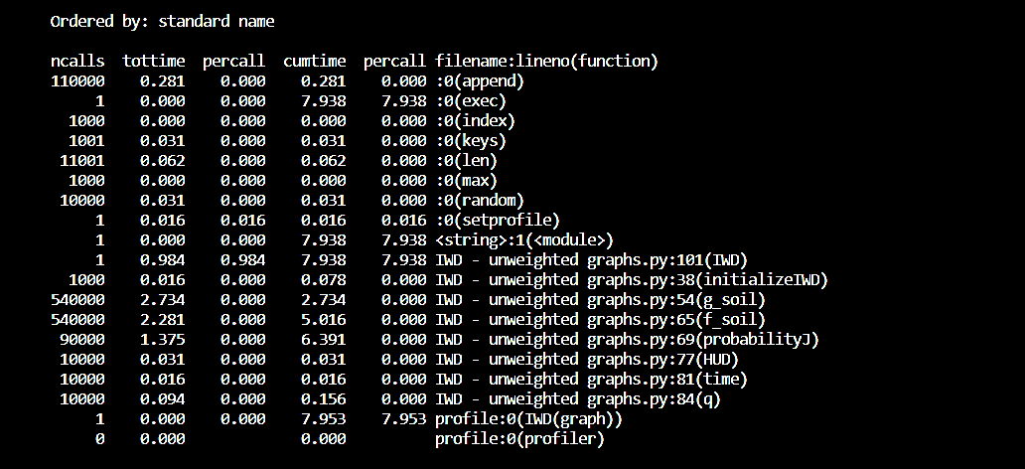
FURTHER OPTIMIZATION
Method 1: Minimizing value of itermax
Method 2: Finding hotspot function and optimizing it

Slide 11
references
Camacho-Villalón, C. L., Dorigo , M., & Stützle , T. (2019). The intelligent water drops algorithm: why it cannot be considered a novel algorithm. SpringerLink.
A Survey on Intelligent Water Drop Algorithm. (2014). Researchgate.
Kalra, M., & Singh, S. (2017). Application of intelligent water drops algorithm to workflow scheduling in cloud environment. IEEE.
O Alijla, B., Wong, L.-P., Lim, C. P., Khader, A. T., & Betar, M. A. (2014). A modified Intelligent Water Drops algorithm and its application to optimization problems. ScienceDirect.
Sarani, S., & Dariane, A. (2013). Application of Intelligent Water Drops Algorithm in Reservoir Operation. SpringerLink.
Shah‐Hosseini, H. (2008). Intelligent water drops algorithm. International Journal Of Intelligent Computing And Cybernetics, 1(2), 193-212. doi: 10.1108/17563780810874717
Hosseini, H. (2009). The intelligent water drops algorithm: a nature-inspired swarm-based optimization algorithm. International Journal Of Bio-Inspired Computation, 1(1/2), 71. doi: 10.1504/ijbic.2009.022775
Shah-Hosseini, H. (n.d.). The intelligent water drops algorithm: a nature-inspired swarm-based optimization algorithm . In Int. J. Bio-Inspired Computation, . Tehran.
Shah‐Hosseini, H. (2008). Intelligent water drops algorithm. International Journal Of Intelligent Computing And Cybernetics, 1(2), 193-212. doi: 10.1108/17563780810874717

